Slide 1
The new era of PHP frameworks
Juozas “Joe” Kaziukėnas
http://juokaz.com / juozas@juokaz.com / @juokaz

Slide 2

Who is this guy?
Juozas Kaziukėnas, Lithuanian
You can call me Joe
3 years in Edinburgh, UK
CEO of Web Species
Occasional open source developer
Conferences speaker
More info in http://juokaz.com
Tweet me @juokaz

Slide 3


Slide 4
I’m too young
To have used any frameworks released before ~2005

Slide 5
What we have now?
What’s the state?

Slide 6
What we have now?
A lot of frameworks
They changed PHP as a whole
Not much projects based on frameworks
Usage is still growing
Frameworks are pushing PHP
Are we happy?
I am, up to some level

Slide 7
How it was done?
Initial designs
Legacy code
Configuration vs. conventions
We didn’t knew what we wanted to have
We figured out on a way
Not all things can be fixed though
Managed to get it all working
Think pre ZF 1.5, or even ZF 1.0

Slide 8
Usage
PHP4 support
All frameworks claim to be the fastest
Is performance actually they key?
MVC is slightly different in each of them
1-5 year old code and paradigms used today
Paradigms change

Slide 9
What’s broken?
If anything

Slide 10
Magic
Everything somehow happens, no one knows why
Or how
Because of __get and __set, and __call etc.
They are slow
API is unclear
Allow crazy things like multi-inheritance
Doctrine 1 behaviors

Slide 11
OOP vs SCOP
Object oriented programming
Static class oriented programming
require_once 'path/to/F3.php';
F3::route('GET /','home');
function home() {
echo 'Hello, world!';
}
F3::run();

Slide 12
Fat frameworks
Full-stack frameworks…
ZF is called bloated
Is it?
3rd party libraries
PEAR components
Reinventing the wheel

Slide 13
Documentation
Steep-learning curve
Is that a feature?
No real tutorials
No “official” pattern

Slide 14
Can it be improved?

Slide 15
Can it be improved?
Completely new concepts
Yes and we are all doing it
Feedback drives it
Rewriting from scratch?
Standards
Agreements
Consistent
PHP 5.3 all the way!

Slide 16
2011 – new era
My idea of having a calling for it

Slide 17
2011 – new era
Let’s define pre-2011 as first phase
Can we call before ZF and Symfony frameworks as frameworks?
I haven’t used them
This year frameworks are entering a second phase
Interesting things will happen

Slide 18
PHP is no longer PHP
PHP4 vs. PHP5.3
PHP is not about PHP-only anymore
Integration with services and tools matter
Fixating to one framework happens less and less

Slide 19
Releases
2011 the year all new ideas get released
Most of them
Major frameworks’ releases
Improved ideas
PHP 5.3-only releases appear

Slide 20
Git
SVN is no longer here
Git drives development
Pull requests per day = ?
Easier to contribute
PHP is now on Git too
No more access to commit
ZF still asks for CLA
Will create potential forks in a future?

Slide 21
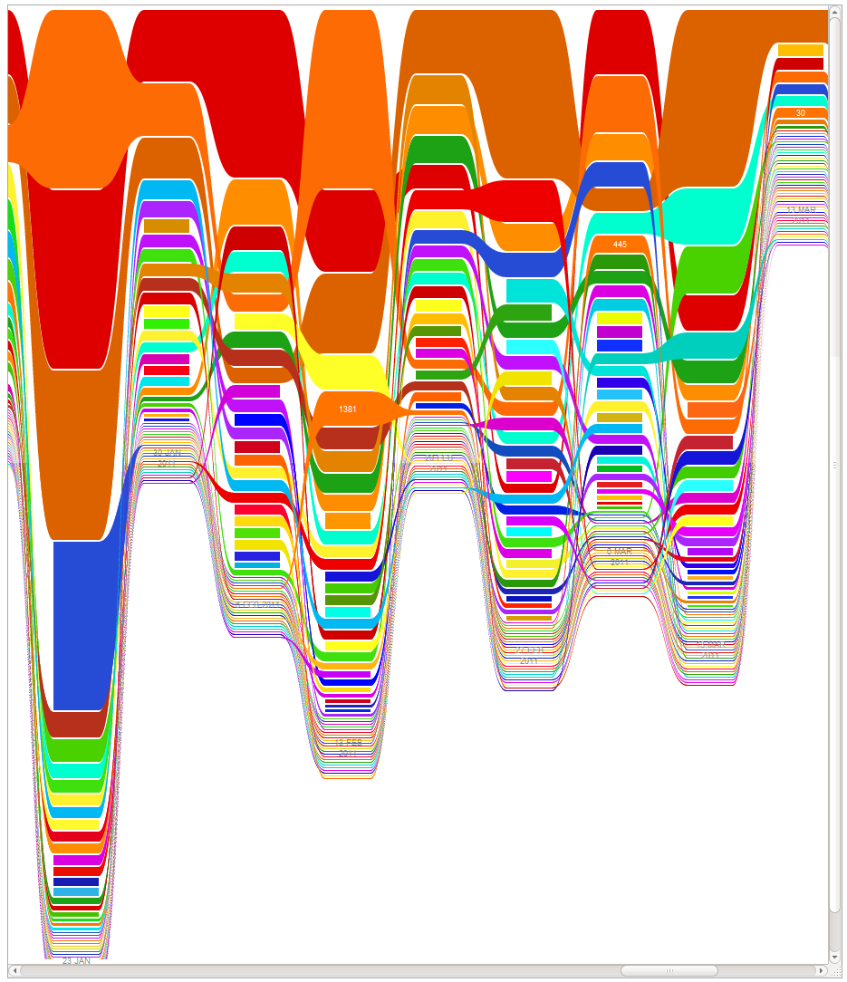
* Symfony2 contributions

Slide 22
What they are fixing?
Most of the frameworks

Slide 23
Magic
Removed
Explicit methods and variables
Produces clean code
Some functionality is gone

Slide 24
Fat frameworks
Small core
Separating elements into components
Reusing existing libraries
Like Doctrine

Slide 25
Documentation
A lot more cleaner
More comprehensive
Tutorials
Reduce entry barrier

Slide 26
Performance
A major achievement
Lower memory usage too
PHP level
Frontend level
Headers
ESI
Assets

Slide 27
What’s new?

Slide 28
Namespaces
PHP 5.3 feature
Helps for frameworks like ZF a lot
No more “_”
Clean code
use Zend\Http\Request;
$request = new Request();

Slide 29
Standard Autoloading
PSR-0 standard
Examples
\Zend\Acl => /Zend/Acl.php
\Doctrine\Common\IsolatedClassLoader => /Doctrine/Common/IsolatedClassLoader.php
\Zend\Mail_Message => /Zend/Mail_Message.php
A recommended approach by all

Slide 30
Annotations
Configuration inside source code
Coming from Java et al world
Improves RAD
/**
* @Meta\User(namespace=“speaker")
* @Meta\Talks\PHP(topic=“frameworks")
*/
class User
{ }

Slide 31
Dependency Injection
Singletons suck
Must have for clean code
Helps for testing
Containers mike life easy
Auto-injecting dependencies
public function __construct(Mailer $mailer, DB $db);

Slide 32
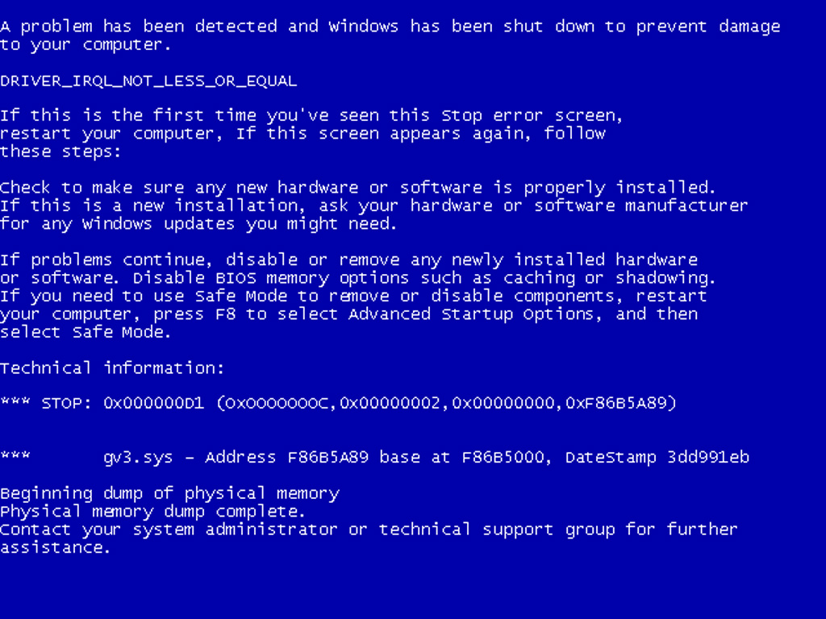

Slide 33
Interoperability
Platform independence
Windows support
SQL Server support
Cloud support
NoSQL support

Slide 34
REST
APIs are now very common
Proper support for it
RestBundle in Symfony2
Routes
Data formats
OAuth

Slide 35
ze Java
ze == the

Slide 36
Java
Good cop vs bad cop
I’m not a cop
XML files
We used to like YAML, not anymore?..
Patterns moving to PHP
Dependency Injection Container (DIC)
Is this a good thing?

Slide 37
Microframeworks

Slide 38
Microframeworks
Solve different problems
In a different way
Not a new thing, but PHP 5.3 cleans them
Popular example is Silex
There is a ton more
Simple, fast to work with
It’s not about simple API, framework should be small too

Slide 39
Silex
Really simple setup
$app = new Silex\Application();
$app->get('/hello/{name}',
function($name) {
return "Hello $name";
});
$app->run();

Slide 40
Frameworks
I chose 3 to show

Slide 41
Zend Framework 2
Long process
Converting to Namespaces
Autoloading
MVC
Internationalization
Documentation
Componetization

Slide 42
ZF 2 classmap loader
Can be used in ZF 1
Fastest way to load classes
$loader = new Zend\Loader\ClassMapAutoloader();
$loader->registerMap(__DIR__ . '/../library/Zend/.classmap.php');

Slide 43
Lithium
A different kind of framework
Claim to be the most RAD
Aspect oriented programming
Integrates really well with
CouchDB
MongoDB

Slide 44
Lithium AOP
Adding functionality to methods without changing them
Allows boring stuff to be done easily
Connections::get('default')->applyFilter('_execute', function($self, $params, $chain) {
Logger::debug($params['sql']);
return $chain->next($self, $params, $chain);
});

Slide 45
Symfony2
Not Symfony 2, but Symfony2
Leading the pack
Already released
Doesn’t share anything with Symfony 1
Bundles
Used in production

Slide 46
Symfony2 bundles
public function registerBundles() {
$bundles = array(
new Symfony\Bundle\FrameworkBundle\FrameworkBundle(),
new Symfony\Bundle\TwigBundle\TwigBundle(),
new Symfony\Bundle\DoctrineBundle\DoctrineBundle(),
// register your bundles
new Acme\StudyBundle\AcmeStudyBundle(),
);
if (in_array($this->getEnvironment(), array('dev', 'test'))) {
$bundles[] = new Symfony\Bundle\WebProfilerBundle\WebProfilerBundle();
}
return $bundles;
}

Slide 47
Releases

Slide 48
Releases
Symfony2 Stable
ZF 2 god knows when sometime next year?..
Lithium dev release
Alloy 0.7 beta
Fuel 1.0RC2
Fat-free framework 1.4, 2.0 in works
Flow3 1.0 alpha

Slide 49
Conclusion

Slide 50
Conclusion
Time to fix things now
This year frameworks release new major versions
Completely different ideas
Will last for coming 5 years
PHP 5.3 as the main factor
Community driven development (Git)
New PHP experience and features

Slide 51
Questions?

Slide 52
Thanks!
Juozas Kaziukėnas
http://juokaz.com
juozas@juokaz.com
twitter: @juokaz
Rate this talk at http://joind.in/3656

